Slide 1
Background Tasks
Android Developer Fundamentals
Lesson 7
This work is licensed under a Creative Commons Attribution-NonCommercial 4.0 International License

Slide 2
7.1 AsyncTask & AsyncTaskLoader
This work is licensed under a Creative Commons Attribution-NonCommercial 4.0 International License

Slide 3
Contents
Threads
AsyncTask
Loaders
AsyncTaskLoader

Slide 4
Threads

Slide 5
The main thread
Independent path of execution in a running program
Code is executed line by line
App runs on Java thread called "main" or "UI thread"
Draws UI on the screen
Responds to user actions by handling UI events

Slide 6
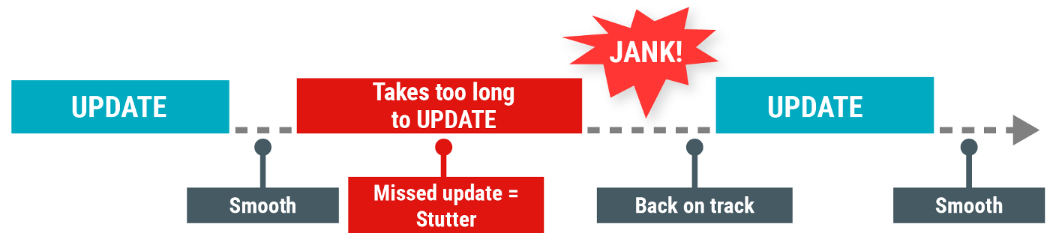
The Main thread must be fast
Hardware updates screen every 16 milliseconds
UI thread has 16 ms to do all its work
If it takes too long, app stutters or hangs
WAIT

Slide 7
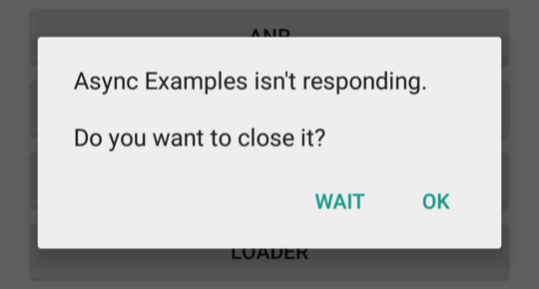
Users uninstall unresponsive apps
If the UI waits too long for an operation to finish, it becomes unresponsive
The framework shows an Application Not Responding (ANR) dialog

Slide 8
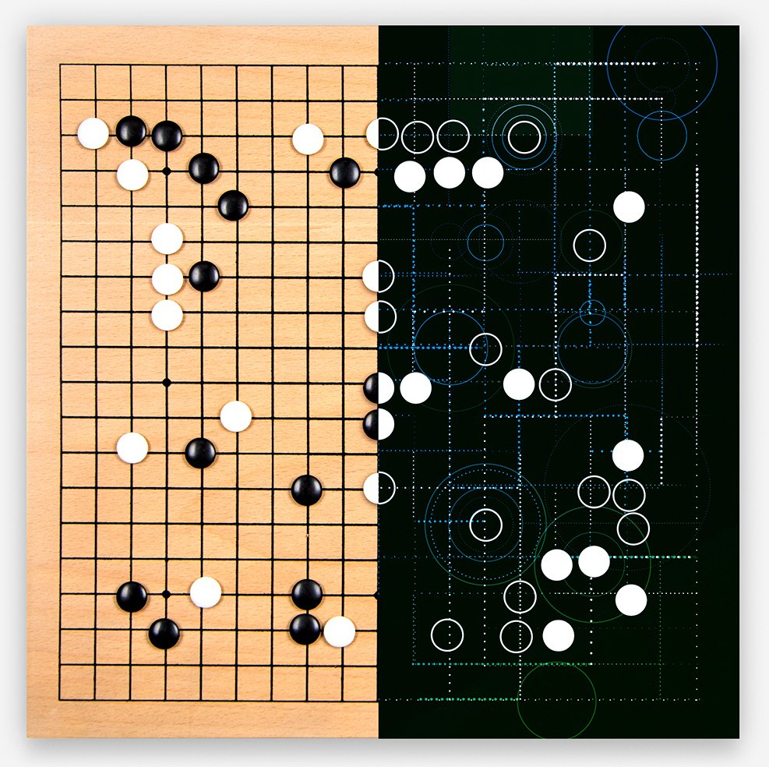
What is a long running task?
What is a long running task?
Network operations
Long calculations
Downloading/uploading files
Processing images
Loading data

Slide 9
Background threads
Execute long running tasks on a background thread
AsyncTask
The Loader Framework
Services
Main Thread (UI Thread)
Update UI
Worker Thread
Do some work
Notes:
The method depends on the use case

Slide 10
Two rules for Android threads
Do not block the UI thread
Complete all work in less than 16 ms for each screen
Run slow non-UI work on a non-UI thread
Do not access the Android UI toolkit from outside the UI thread
Do UI work only on the UI thread

Slide 11
AsyncTask

Slide 12
What is AsyncTask?
Use AsyncTask to implement basic background tasks
Main Thread (UI Thread)
onPostExecute()
Worker Thread
doInBackground()

Slide 13
Override two methods
doInBackground()—runs on a background thread
All the work to happen in the background
onPostExecute()—runs on main thread when work done
Process results
Publish results to the UI

Slide 14
AsyncTask helper methods
onPreExecute()
Runs on the main thread
Sets up the task
onProgressUpdate()
Runs on the main thread
receives calls from publishProgress() from background thread

Slide 15
AsyncTask helper methods
Main Thread (UI Thread)
onPreExecute()
onProgressUpdate()
onPostExecute()
Worker Thread
publishProgress()
doInBackground()

Slide 16
Creating an AsyncTask
Subclass AsyncTask
Provide data type sent to doInBackground()
Provide data type of progress units for onProgressUpdate()
Provide data type of result for onPostExecute()
private class MyAsyncTask
extends AsyncTask<URL, Integer, Bitmap> {...}

Slide 17
MyAsyncTask class definition
private class MyAsyncTask
extends AsyncTask<String, Integer, Bitmap> {...}
doInBackground()
doInBackground(
String—could be query, URI for filename
Integer—percentage completed, steps done
Bitmap—an image to be displayed
Use Void if no data passed
doInBackground()
onProgressUpdate()
onPostExecute()

Slide 18
onPreExecute()
protected void onPreExecute() {
// display a progress bar
// show a toast
}

Slide 19
doInBackground()
protected Bitmap doInBackground(String... query) {
// Get the bitmap
return bitmap;
}

Slide 20
onProgressUpdate()
protected void onProgressUpdate(Integer... progress) {
setProgressPercent(progress[0]);
}

Slide 21
onPostExecute()
protected void onPostExecute(Bitmap result) {
// Do something with the bitmap
}

Slide 22
Start background work
public void loadImage (View view) {
String query = mEditText.getText().toString();
new MyAsyncTask(query).execute();
}

Slide 23
Limitations of AsyncTask
Limitations of AsyncTask
When device configuration changes, Activity is destroyed
AsyncTask cannot connect to Activity anymore
New AsyncTask created for every config change
Old AsyncTasks stay around
App may run out of memory or crash

Slide 24
When to use AsyncTask
Short or interruptible tasks
Tasks that do not need to report back to UI or user
Lower priority tasks that can be left unfinished
Use AsyncTaskLoader otherwise

Slide 25
Loaders

Slide 26
What is a Loader?
Provides asynchronous loading of data
Reconnects to Activity after configuration change
Can monitor changes in data source and deliver new data
Callbacks implemented in Activity
Many types of loaders available
AsyncTaskLoader, CursorLoader

Slide 27
Why use loaders?
Execute tasks OFF the UI thread
LoaderManager handles configuration changes for you
Efficiently implemented by the framework
Users don't have to wait for data to load

Slide 28
Anatomy of a Loader
What is a LoaderManager?
Manages loader functions via callbacks
Can manage multiple loaders
loader for database data, for AsyncTask data, for internet data…

Slide 29
Get a loader with initLoader()
Creates and starts a loader, or reuses an existing one, including its data
Use restartLoader() to clear data in existing loader
getLoaderManager().initLoader(Id, args, callback);
getLoaderManager().initLoader(0, null, this);
getSupportLoaderManager().initLoader(0, null, this);

Slide 30
Implementing AsyncTaskLoader

Slide 31
AsyncTaskLoader Overview
AsyncTaskLoader
AsyncTask
WorkToDo
LoaderManager
Request Work
Receive Result
Activity

Slide 32
AsyncTask AsyncTaskLoader
doInBackground()
onPostExecute()
loadInBackground()
onLoadFinished()

Slide 33
Steps for AsyncTaskLoader subclass
Subclass AsyncTaskLoader
Implement constructor
loadInBackground()
onStartLoading()

Slide 34
Subclass AsyncTaskLoader
public static class StringListLoader
extends AsyncTaskLoader<List<String>> {
public StringListLoader(Context context, String queryString) {
super(context);
mQueryString = queryString;
}
}

Slide 35
loadInBackground()
public List<String> loadInBackground() {
List<String> data = new ArrayList<String>;
//TODO: Load the data from the network or from a database
return data;
}

Slide 36
onStartLoading()
When restartLoader() or initLoader() is called, the LoaderManager invokes the onStartLoading() callback
Check for cached data
Start observing the data source (if needed)
Call forceLoad() to load the data if there are changes or no cached data
protected void onStartLoading() { forceLoad(); }

Slide 37
Implement loader callbacks in Activity
onCreateLoader() — Create and return a new Loader for the given ID
onLoadFinished() — Called when a previously created loader has finished its load
onLoaderReset() — Called when a previously created loader is being reset making its data unavailable

Slide 38
onCreateLoader()
@Override
public Loader<List<String>> onCreateLoader(int id, Bundle args) {
return new StringListLoader(this,args.getString("queryString"));
}

Slide 39
onLoadFinished()
Results of loadInBackground() are passed to onLoadFinished() where you can display them
public void onLoadFinished(Loader<List<String>> loader, List<String> data) {
mAdapter.setData(data);
}

Slide 40
onLoaderReset()
Only called when loader is destroyed
Leave blank most of the time
@Override
public void onLoaderReset(final LoaderList<String>> loader) { }

Slide 41
Get a loader with initLoader()
In Activity
Use support library to be compatible with more devices
getSupportLoaderManager().initLoader(0, null, this);

Slide 42
Learn more
AsyncTask Reference
AsyncTaskLoader Reference
LoaderManager Reference
Processes and Threads Guide
Loaders Guide
UI Thread Performance: Exceed the Android Speed Limit

Slide 43
What's Next?
Concept Chapter: 7.1 C AsyncTask and AsyncTaskLoader
Practical: 7.1 P Create an AsyncTask

Slide 44
END

